Slide 1
Intro to Angular Universal
Jeffrey So

Slide 2
What Search Engine sees
Meta tag, schema, content at page load (most of the time)
Different search engine have different definition of page load
Most search engine define it literally: the moment <body> shows up, page has loaded
This is known as first contentful paint (FCP)
Google will wait until content is stable or timeout (aka wait after <body> shows up)

Slide 3
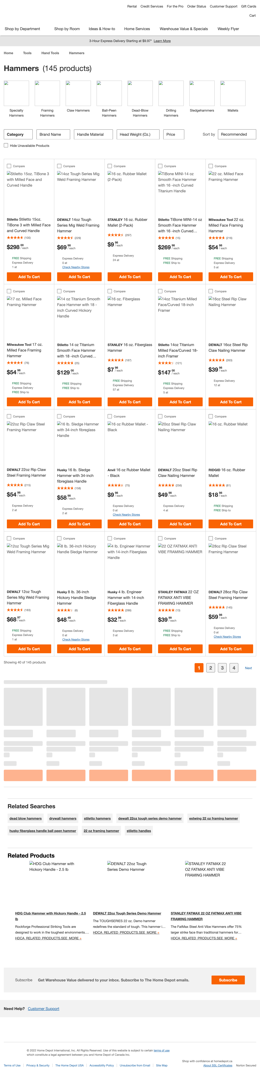
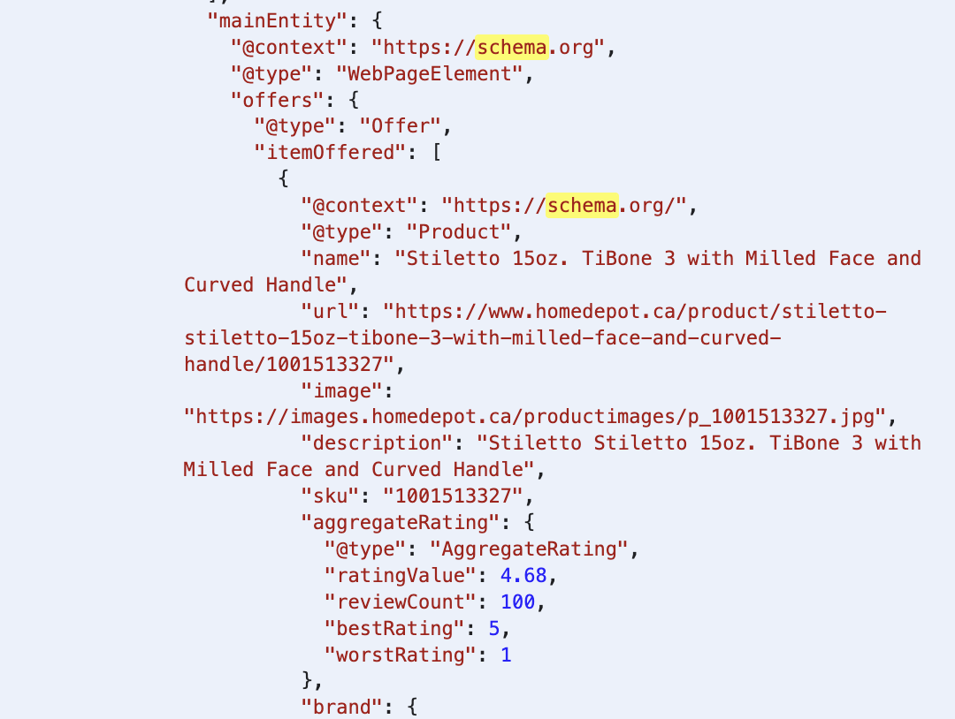
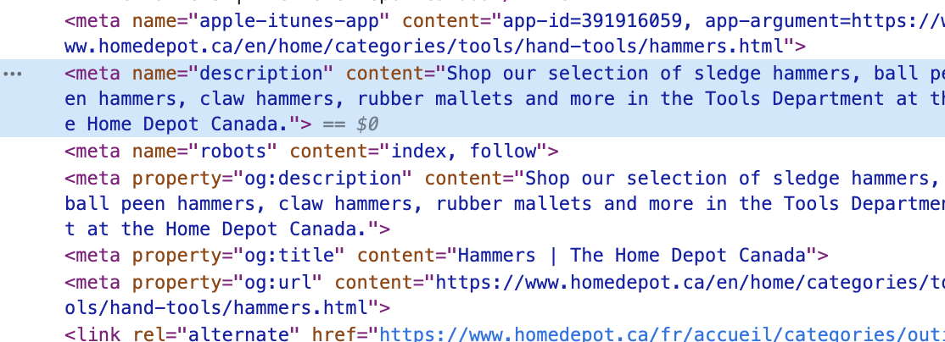
What Search Engine sees: home depot PLP
Product listing page (PLP): https://www.homedepot.ca/en/home/categories/tools/hand-tools/hammers.html
How to test? Network throttling: slow 3g or worse
At page load, first 20 product
Meta tags, schema exist even though page has not fully loaded
Content at page load very important

Slide 4
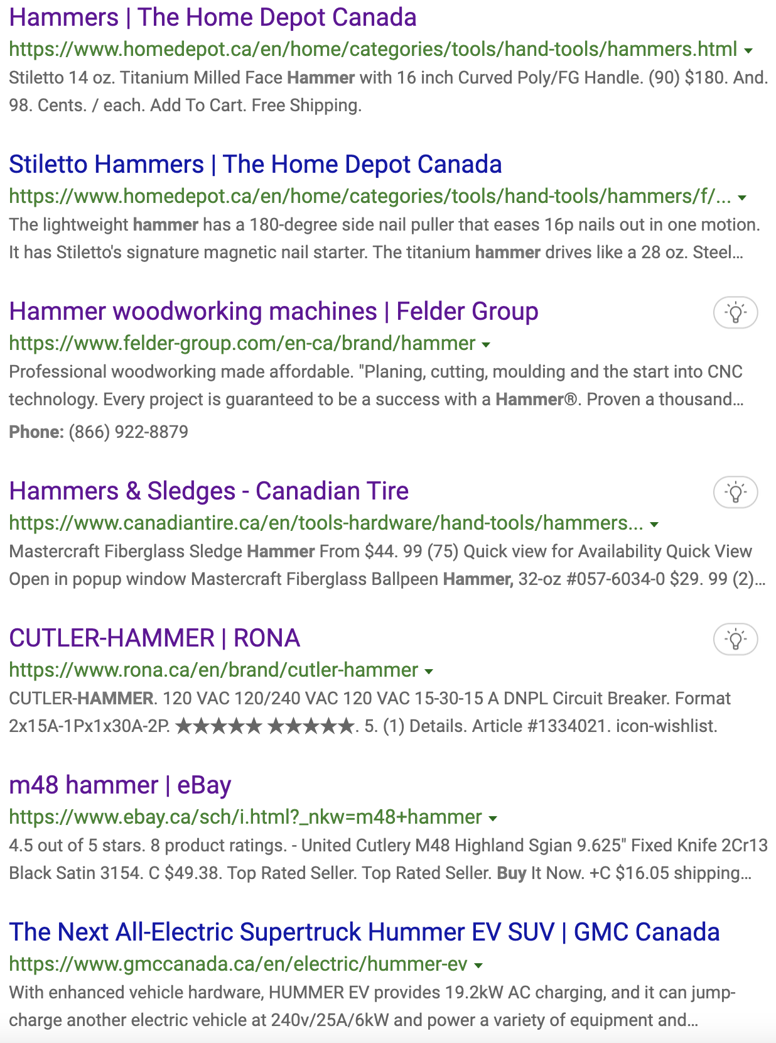
What happens if you have bad SEO (bing)?
Search term: “buy hammer canada”
Home Depot hammer PLP(s)
Austrian power tool company Does not even sell hammer (???)
Power tool company > Canadian Tire and Rona (???)
Lowes does not appear until page 3 on Bing

Slide 5
Why Home depot and Power tool company ranked above Canadian Tire, Rona?
Power of page content at page load (First Contentful Paint)

Slide 6
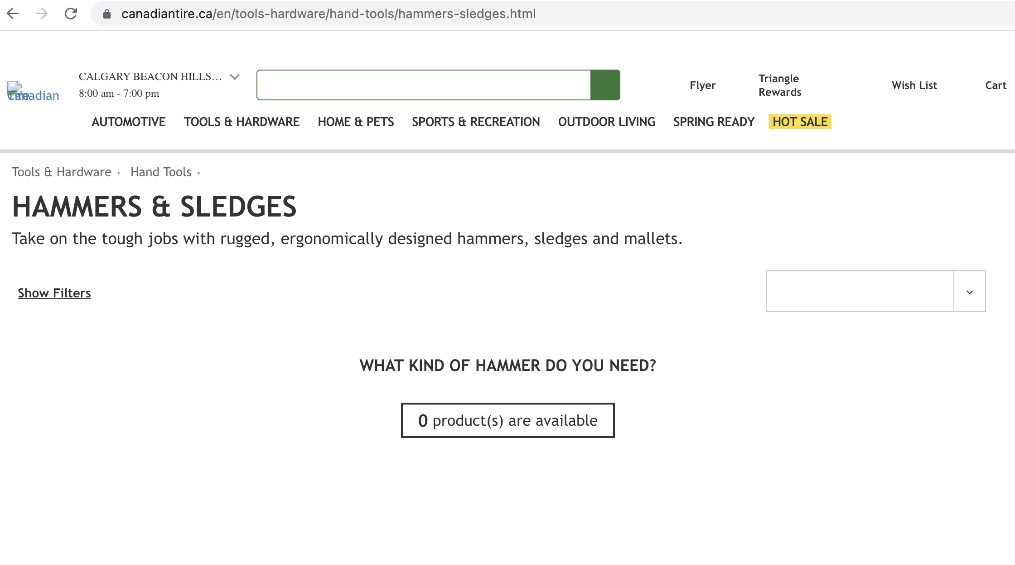
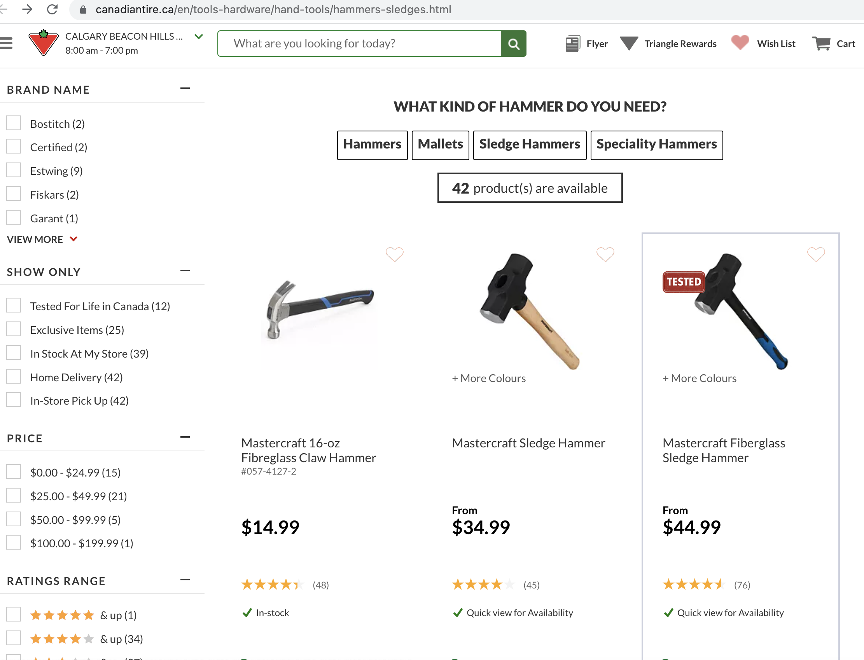
Power of PAGE Load Content: Canadian tire
https://www.canadiantire.ca/en/tools-hardware/hand-tools/hammers-sledges.html
Site built in React, almost working SSR
No hammer at page load Product listings shows up shortly after

Slide 7
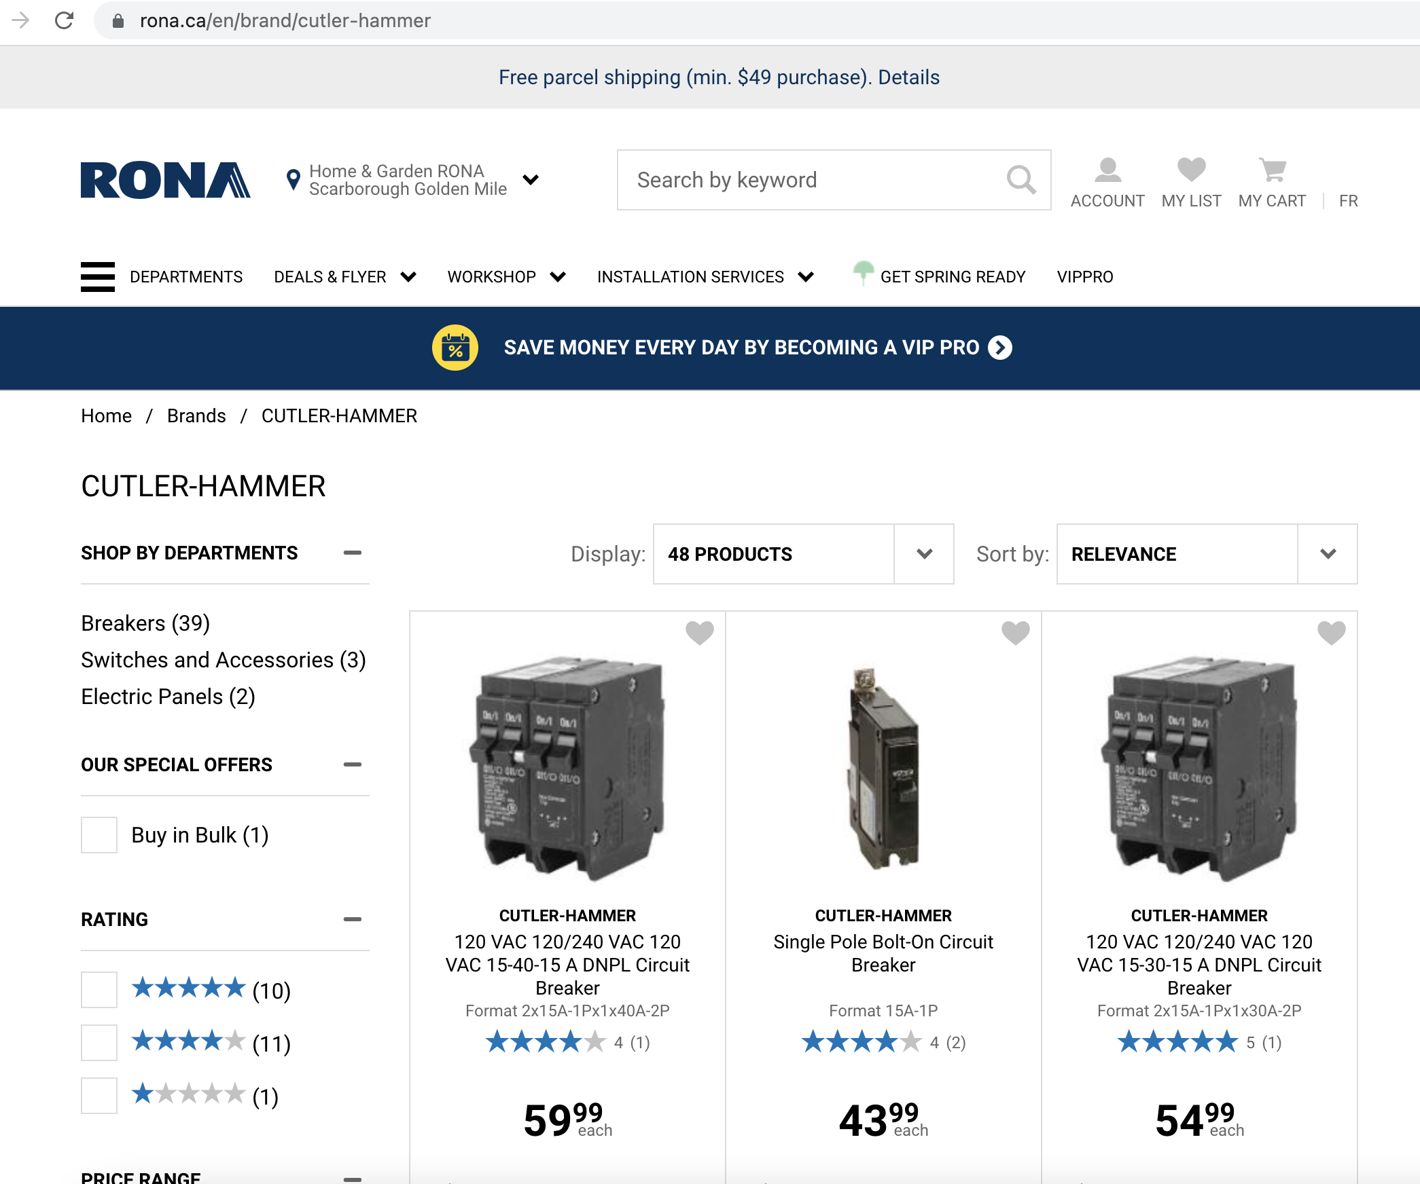
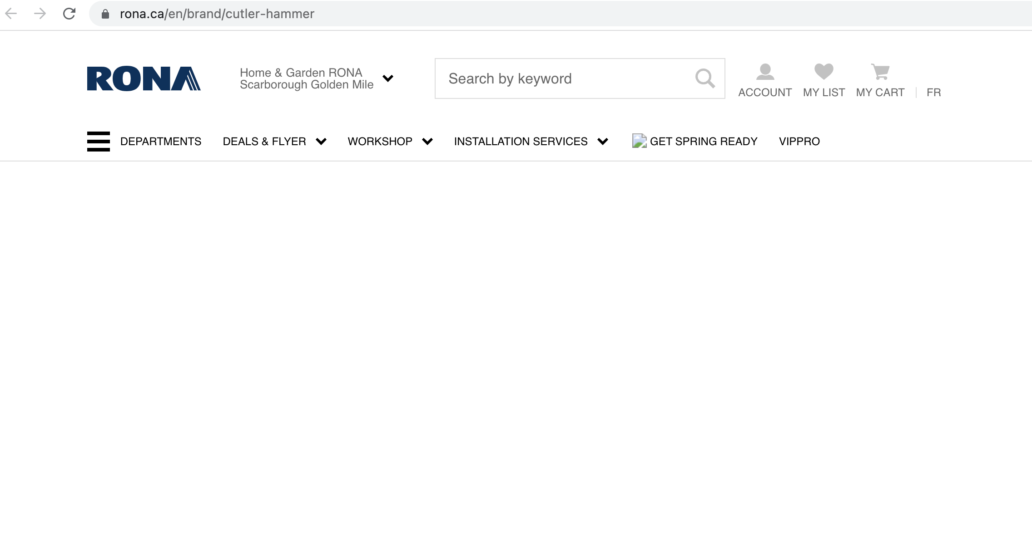
Power of PAGE Load Content: Rona
Wrong category is indexed, shows a brand called cutler hammer
https://www.rona.ca/en/brand/cutler-hammer
Took longer than Canadian Tire
No hammer at page load

Slide 8
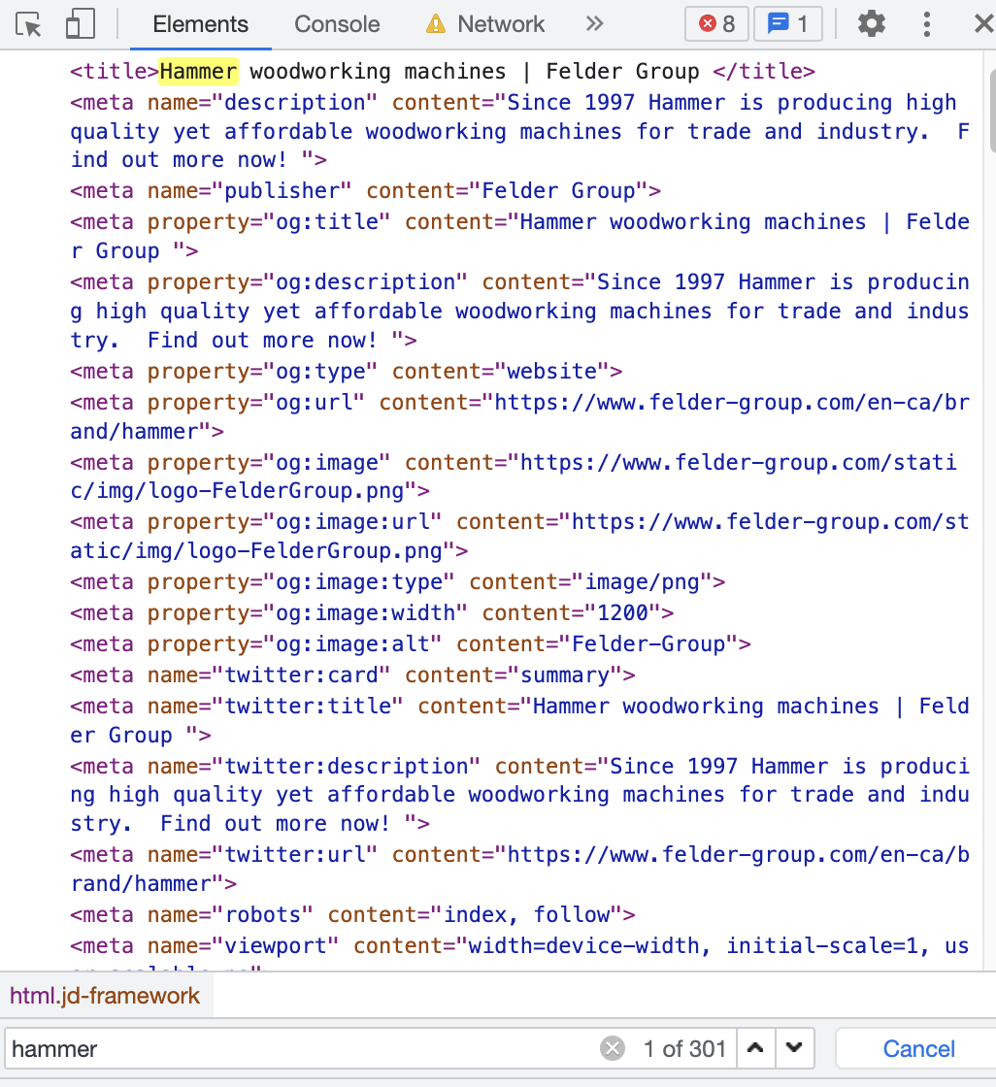
Power of PAGE Load Content: Power tool company
https://www.felder-group.com/en-ca/brand/hammer
Super fast load, most content and meta tags available
301 mentions of hammer at page load

Slide 9
WHY Angular SSR?
Show content at page load

Slide 10
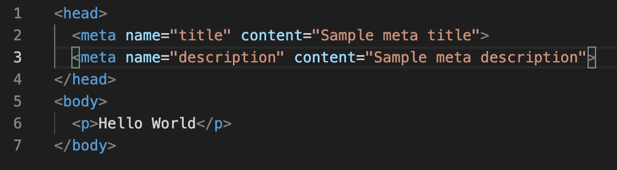
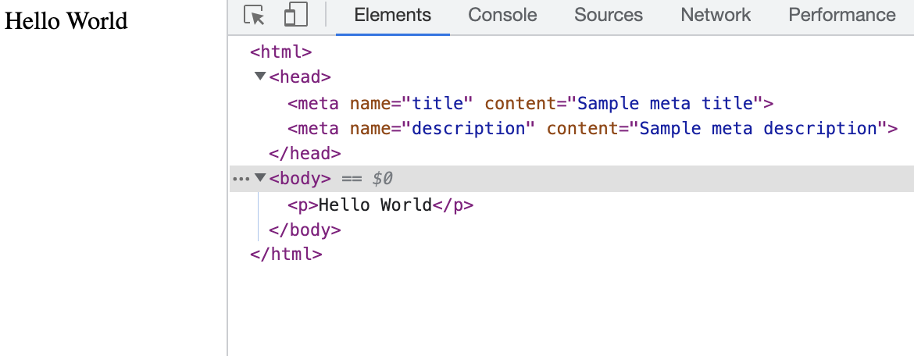
rendering Process: Static PURE HTML
No dynamic content
Everything available at page load
Search engine sees everything at page load
Request
Page Load
UI
GET /page.html
Full Content

Slide 11
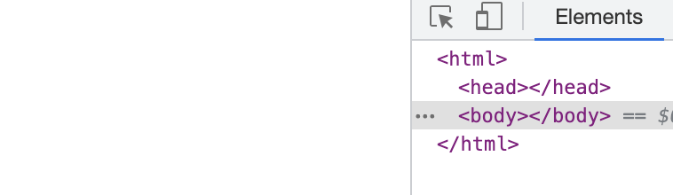
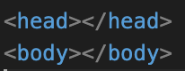
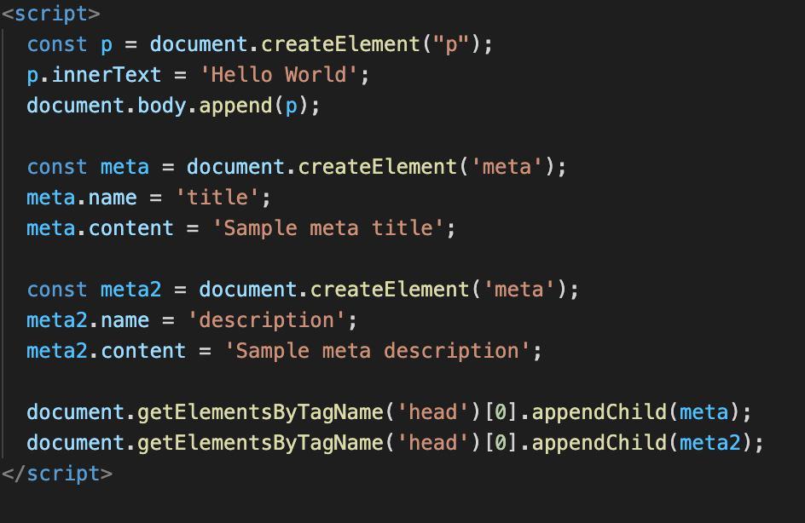
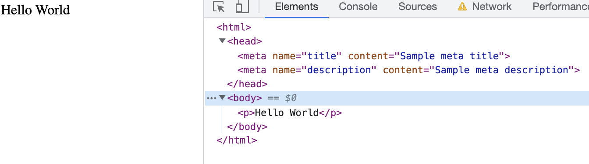
rendering Process : HTML WITH JS
Have dynamic content
JS will add content only after it is loaded
Head and Body is blank at page load
Search engine sees blank at page load
Request
Page Load
UI
GET /page.html
Blank
Full Content
JS
GET /page.js

Slide 12
rendering Process : Normal Angular
git clone https://github.com/jeffreyso1/AngularSSRSample.git
BookAppNormal
Go through the code
Focus on app.module.ts, book-details.component.html, book-details.component.ts

Slide 13
rendering Process : Normal Angular
Exact same as ”html with js”
Have dynamic content
Angular will add content only after it is loaded
Head and Body is blank at page load
Search engine sees blank at page load
Request
Page Load
UI
GET /index.html
Blank
Full Content
JS
GET /bundle.js

Slide 14
Normal Angular DEMO

Slide 15
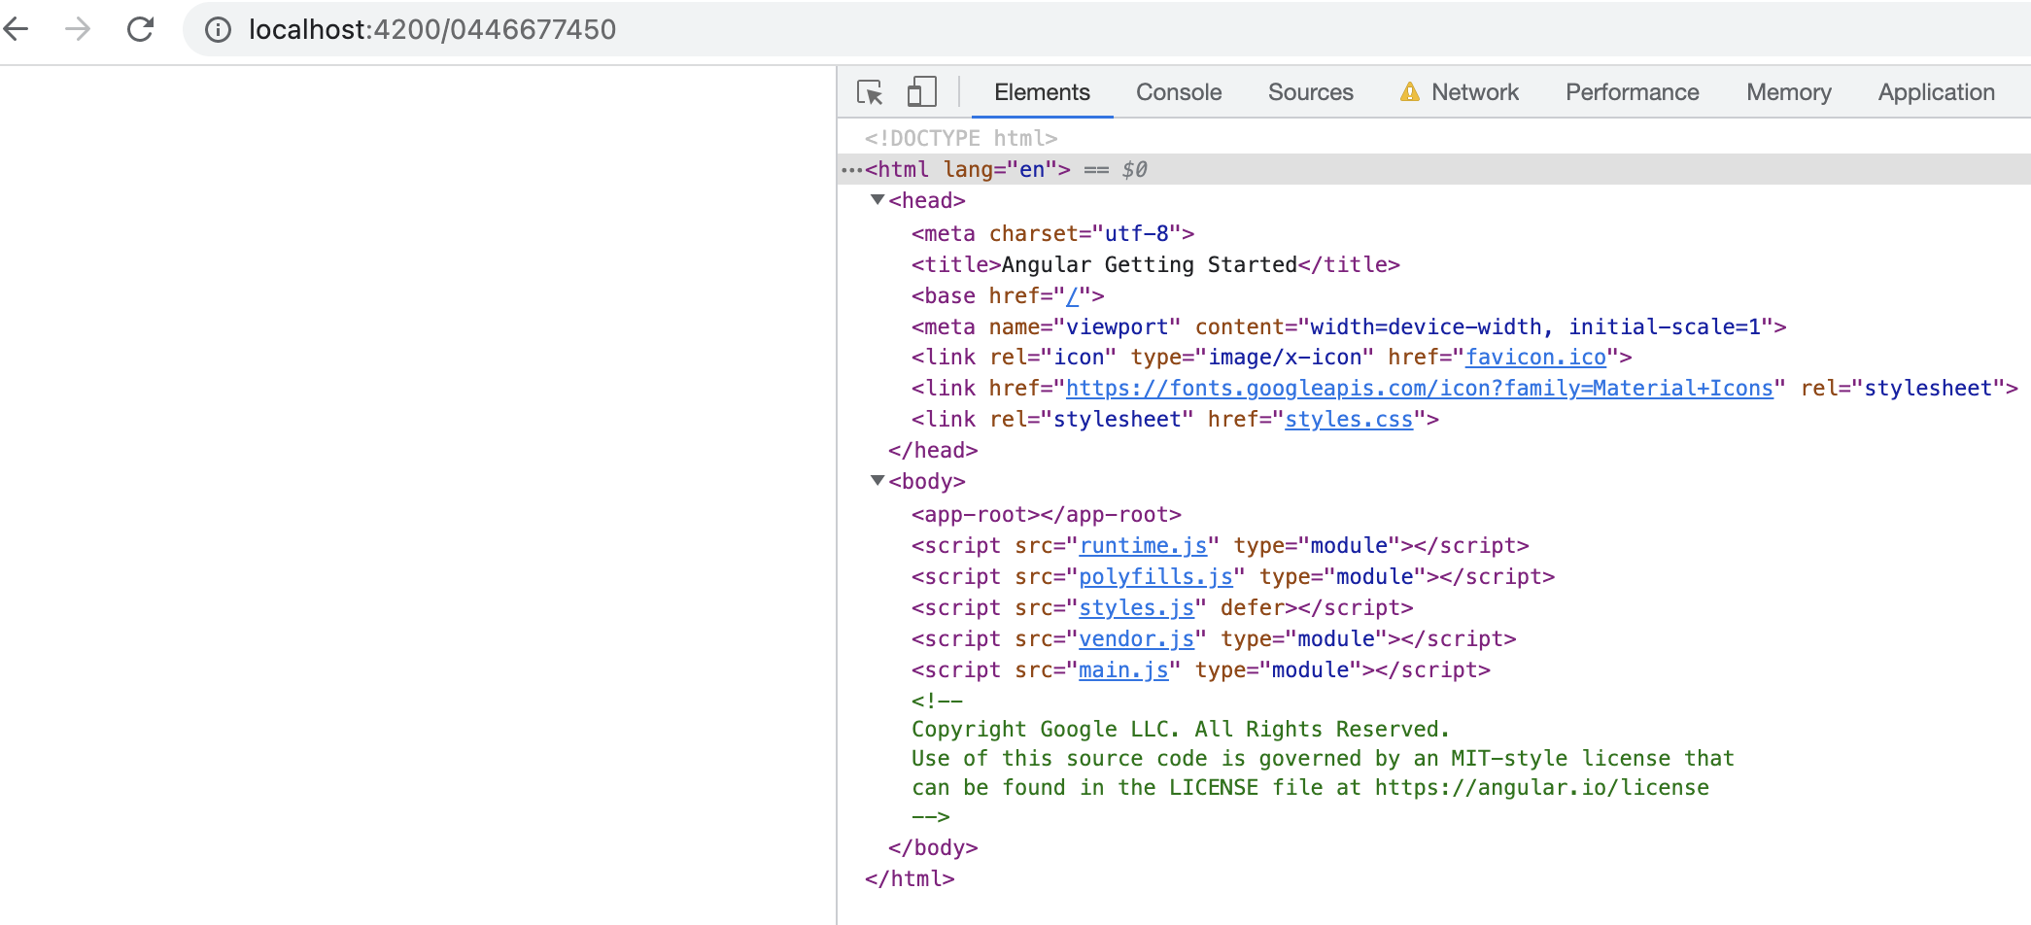
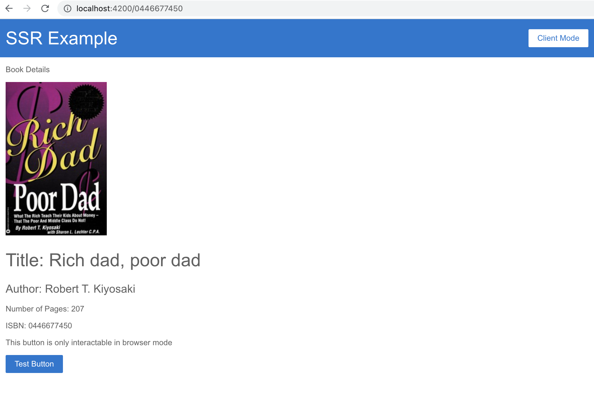
rendering Process : Normal Angular
Head and Body is blank at page load
Search engine sees blank at page load
Request
Page Load
UI
GET /index.html
Blank
Full Content
JS
GET /bundle.js

Slide 16
rendering Process : Angular SSR
git clone https://github.com/jeffreyso1/AngularSSRSample.git
BookAppSSR
Go through the code
Focus on app.module.ts, book-details.component.html, book-details.component.ts

Slide 17
rendering Process : Angular SSR
Node server is running in the background
Node server will respond with some content at page load
Search engine sees some content at page load
Request
Page Load
UI
GET /index.html
Some Content
Full Content
JS
GET /bundle.js
Server
Node server running

Slide 18
SSR Angular DEMO

Slide 19
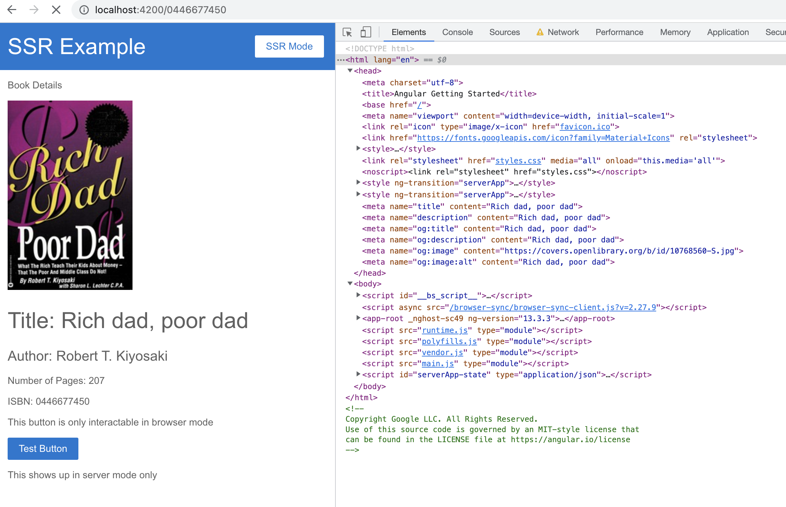
rendering Process : Angular SSR
Head and body available at page load
Button does not work yet
Search engine sees head and body
Request
Page Load
UI
GET /index.html
Some Content
Full Content
JS
GET /bundle.js
Server
Node server running

Slide 20
Code walkthrough

Slide 21
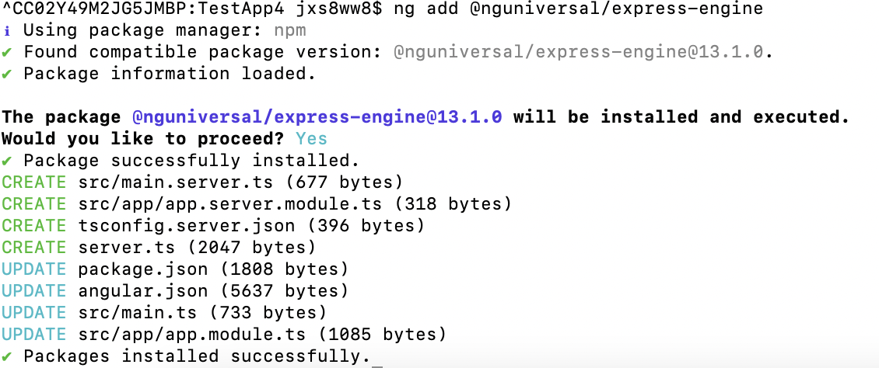
Converting Normal Angular to SSR Angular
Step 1
ng add @nguniversal/express-engine
This command will generate a bunch of files. Do not need to touch most of them.

Slide 22
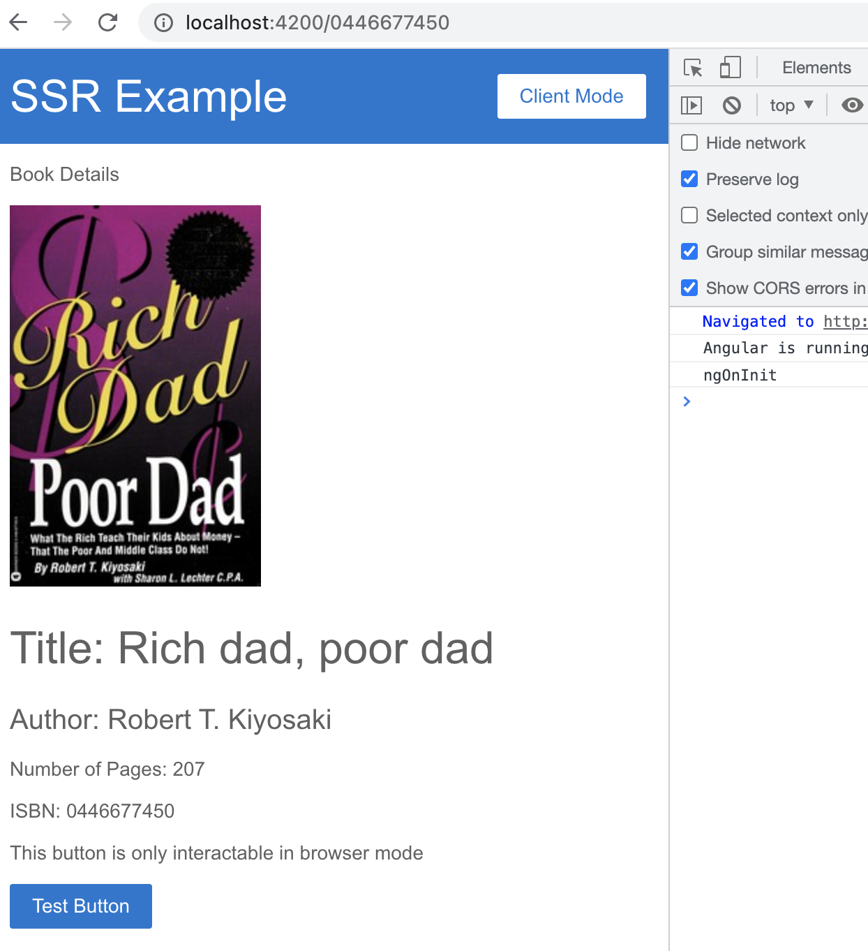
Step 1: ng add @nguniversal/express-engine
App will mostly work
Except ngOnInit is called once in server and once in browser
To solve this, use resolver pattern and save data

Slide 23
Step 2: resolver
Important files (in order): app.module.ts, book.resolver.ts, book-details.component.ts, app.server.module.ts
What resolver does?
Before page is entered, execute what is inside resolver first (calling API)
After that, save the data to be used when page is entered

Slide 24
Step 2: resolver
Important files (in order): app.module.ts, book.resolver.ts, book-details.component.ts, app.server.module.ts
Observe that api call is moved from book-details.component.ts to book.resolver.ts

Slide 25
Step 3: Snippets isplatformbrowser
Important files (in order): top-bar.component.ts, top-bar.component.html
In SSR, all page lifecycle hook (and resolver) is called twice
Anything inside If(isPlatformBrowser) is only called in browser
Anything inside If(isPlatformServer) is only called in server
Anything inside If(isplatformbrowser) is only called in browser

Slide 26
Step 4: Snippets appShellNoRender
Important files (in order): book-details.component.html, appShellNoRender.directive.ts, appShellRender.directive.ts
Controls what gets rendered in server mode and browser mode
<p *appShellNoRender>This shows up in client mode only</p>
<p *appShellRender>This shows up in server mode only</p>

